Slide 1
Mathematical modeling

Slide 2
Introduction
KVPY Summer research camps
Computational Science
Magnetocaloric effect
What I have covered in presentation
Work done and its applications.
Algorithms and modeling process and underlying mathematics and physics.
Less emphasis is given on algorithmic details of implementation in MATLAB.

Slide 3
Model
Build to understand the subject matter they represent.
Physical models
Conceptual models
Mathematical models/ scientific models
Conclusion: Modeling is done to simplify the details of something complex and study its nature better.

Slide 4
Mathematical models
Used in situations in which impossible/ impractical and inconvenient to create experimental conditions to directly measure outcomes.
Outcomes or predictions of models is not accurate due to abstractness of model(assumptions).

Slide 5
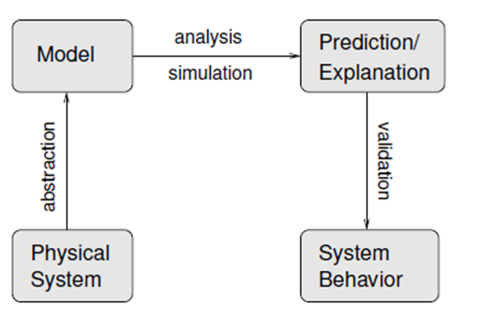
Modeling process

Slide 6
Simulation in computers
Feed the abstract system/mathematical model with the desired input and get predicted output.
Dynamical response.
Study state response.
Studying various characteristics and dynamics of the system.
Unavailability of the real system.

Slide 7
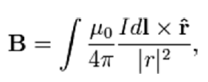
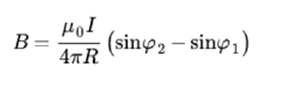
Static models - calculation of magnetic field due to line wire
Biot-savart law
The available analytical solution

Slide 8
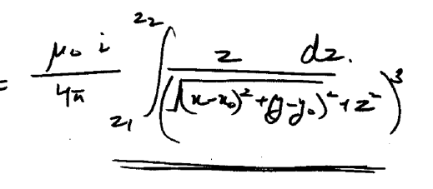
calculation of magnetic field due to line wire – numerical
After doing some mathematical manipulations (on page no-14)

Slide 9
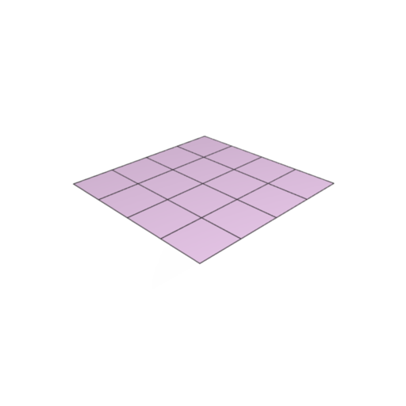
calculation of magnetic field due to line wire – MATLAB
Create a MESHGRID
Quad (Numerical integration) – calculates integral using recursive adaptive Simpson quadrature
Plot the surface plot

Slide 10
calculation of magnetic field due to line wire – surface plot

Slide 11
Dynamical systems
Evolution rule – what future states follow from the current state – a deterministic law
Generally involves non linear differential equations which are not possible to solve analytically.
ODE Solvers in MATLAB – ode45 variable step Runga-Kutta method

Slide 12
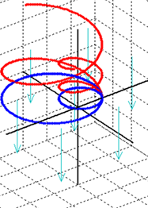
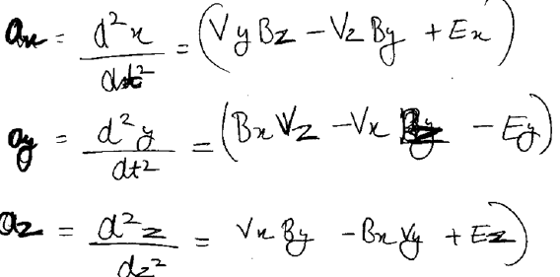
Modeling a particle in electromagnetic field
What aspects to model and WHY?
Position at a future time t.
Trajectory of particle given E and B
Effect of attributes (mass, charge etc)
The deterministic rule of evolution.

Slide 13
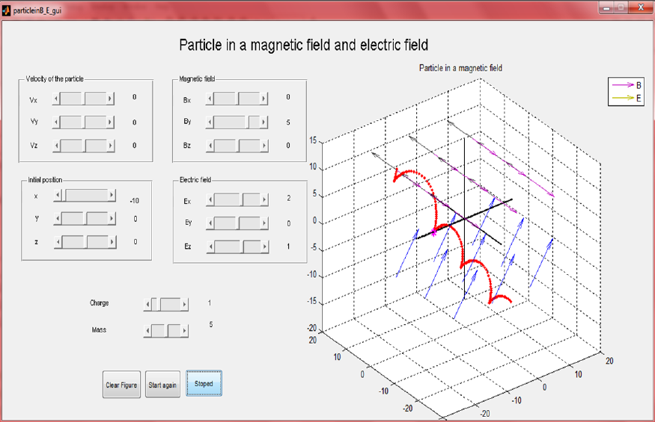
GUI of the simulation – what we have achieved

Slide 14
Deterministic chaos
Chaos theory explains behavior of dynamical system which are inherently very sensitive to initial conditions.
Even though there are no random elements involved system becomes unpredictable due to large deviations arising from small errors in calculation (round off errors).
The system is deterministic in nature because a well defined relation exist in the form of DE but the DE’s are inherently chaotic so calculation is impossible.

Slide 15
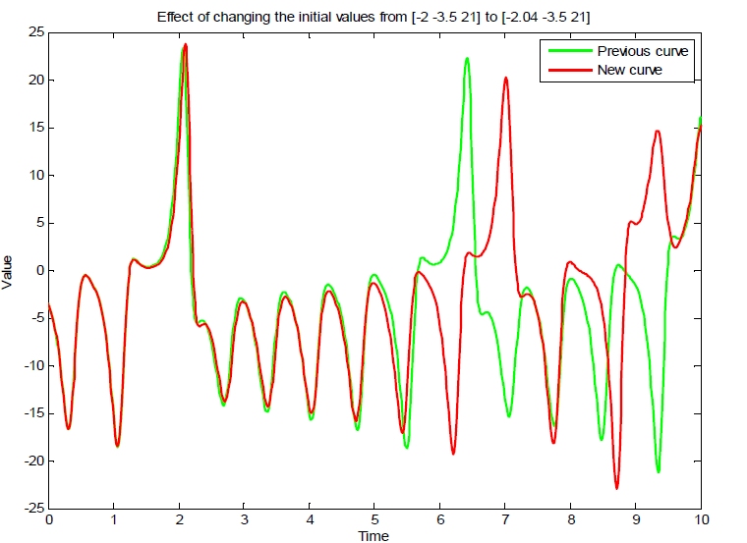
Lorenz equations

Slide 16

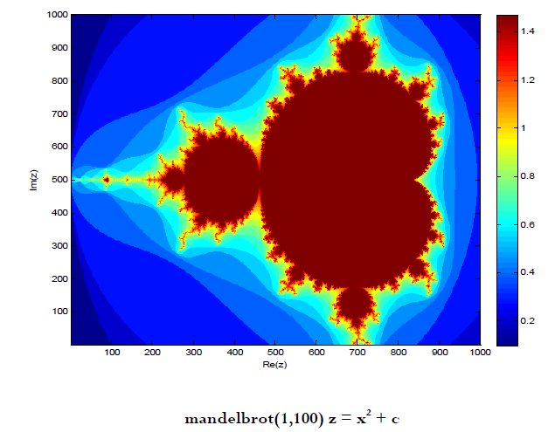
Mandelbrot set

Slide 17
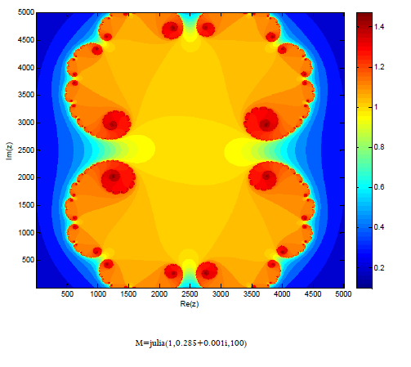
Julia set

Slide 18
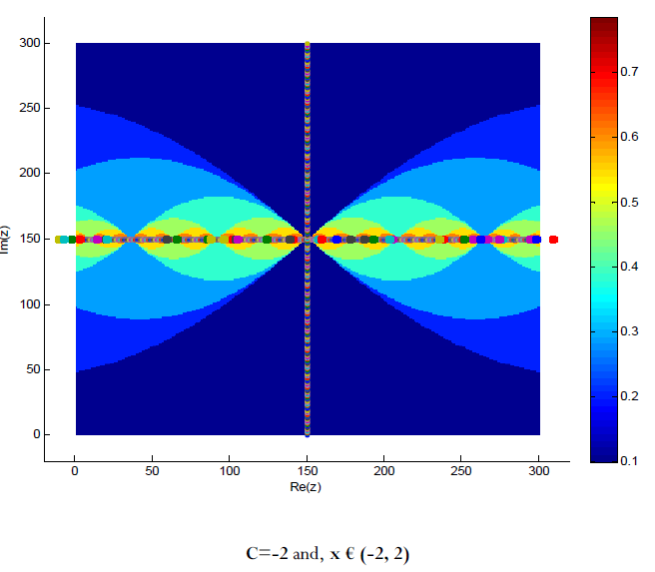
Pseudo random number generator

Slide 19
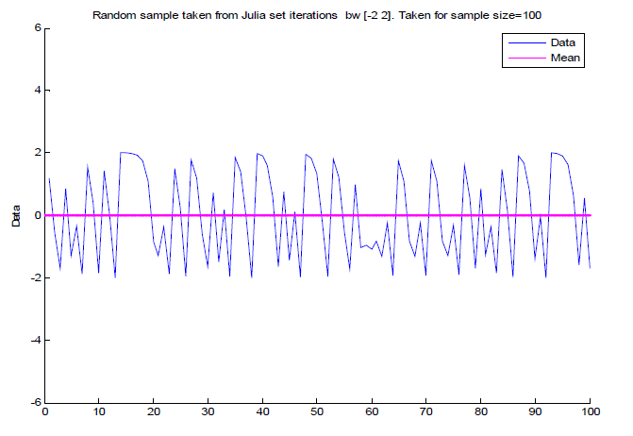
Testing quality of random numbers

Slide 20
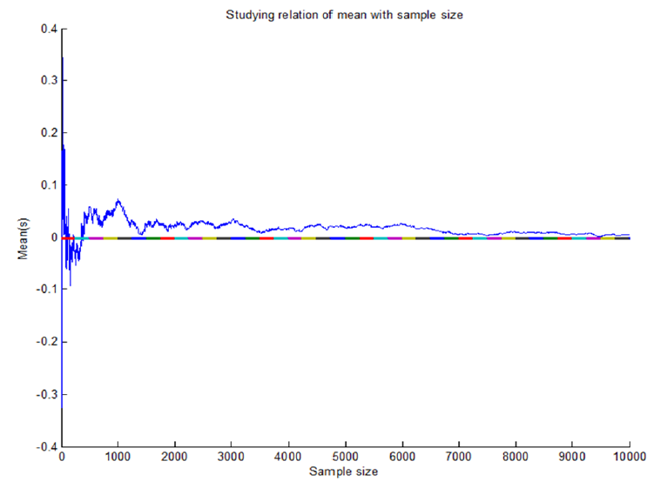
Mean vs sample size

Slide 21
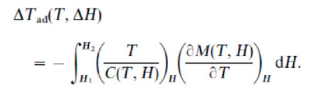
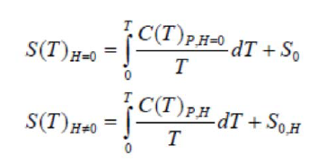
Magnetocaloric effect
DATA
PPMS VMS Magnetometer
50 oestred
0 oestred

Slide 22
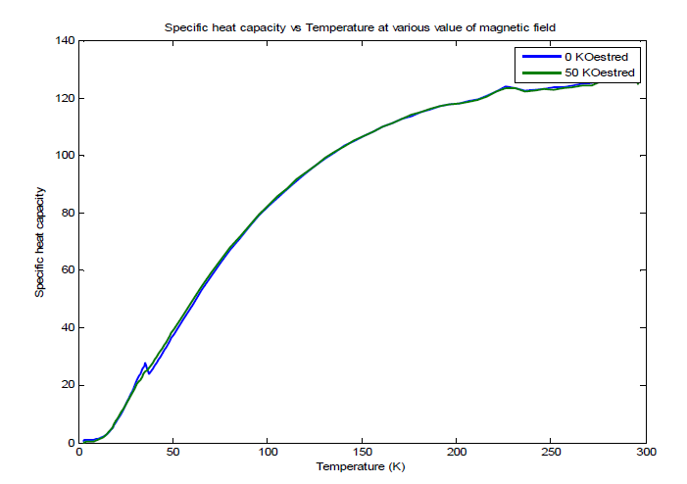
Specific heat capacity plots

Slide 23
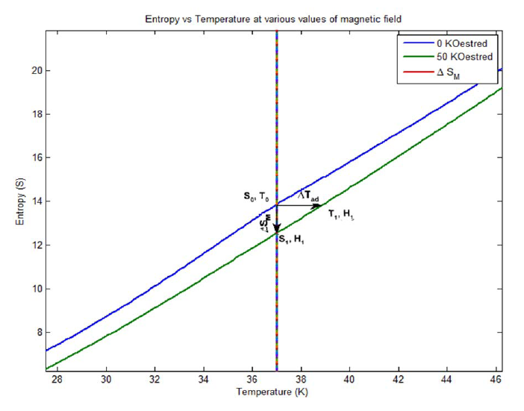
Entropy vs temperature

Slide 24
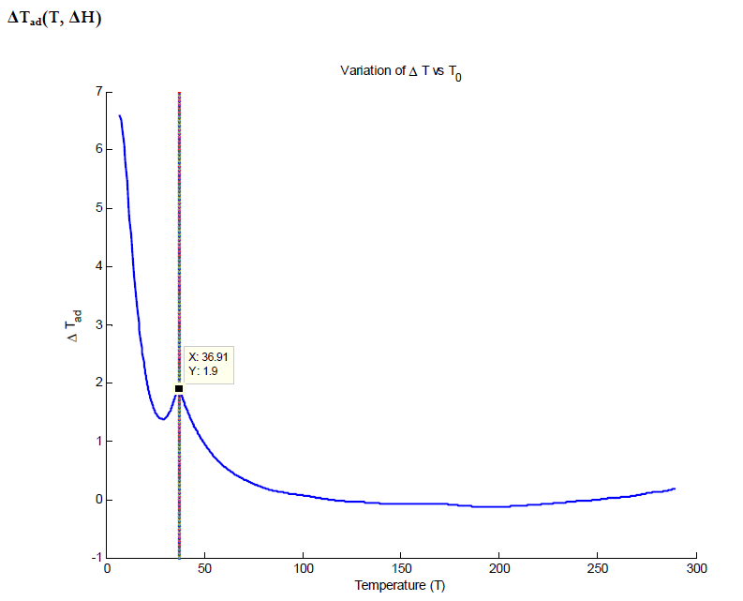
Delta T_{ad} and T

Slide 25
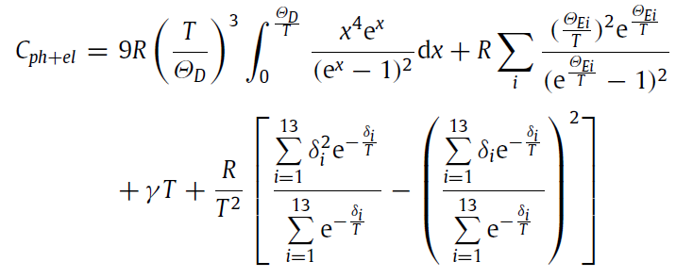
Specific heat capacity model

Slide 26
Curve fitting el + ph
Coefficients (with 95% confidence bounds):
a = 126.2 (116.8, 135.5)
gama = 0.5126 (0.4926, 0.5327)

Slide 27
All contris
Coefficients (with 95% confidence bounds):
a = -24.17
b = -82.1
c = -41.79
d = -26.48 (-3.179e+010, 3.179e+010)
gama = 0.5126 (0.4919, 0.5333)
thetad = 126.2 (116.5, 135.8)

Slide 28
Thanks

